Slide 1
Inaccessible CAPTCHA: updating W3C advisory note
Dr Scott Hollier
PWAC 2019
Technology for everyone

Slide 2
Who am I?
Professional:
Digital accessibility specialist
Active participant in W3C WAI APA
Research Questions Task Force
Co-founder, Centre For Accessibility initiative
Academic:
Senior Lecturer, Professional Certificate in Web Accessibility, University of South Australia
Adjunct Senior Lecturer, Edith Cowan University
Personal:
Author of book ‘Outrunning the Night’
Legally blind, first-hand knowledge of access issues

Slide 3
What is CAPTCHA?
Completely Automated Public Turing test to Tell Computers and Humans Apart (CAPTCHA)
Purpose: to stop bots from harvesting data

Slide 4
Traditional CAPTCHAs
Task: to identify a distorted set of characters from a bitmapped image, then enter those characters into a form.

Slide 5
CAPTCHAs and web accessibility
Impossible for people with low vision
Incompatible with screen readers making it impossible for blind users
Assumes familiarity with the English character set
Not intuitive making it difficult for people with cognitive disabilities
Alternatives can be difficult too

Slide 6
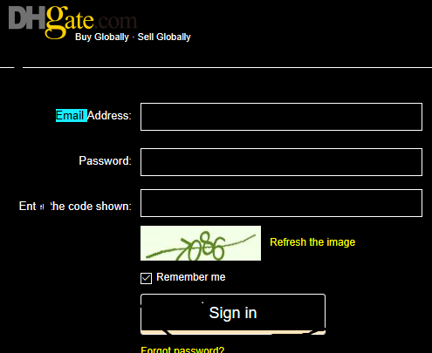
Traditional CAPTCHA issues

Slide 7
Traditional CAPTCHA issues

Slide 8
Audio CAPTCHA
Good luck!

Slide 9
Audio CAPTCHA
Good luck!

Slide 10
W3C WAI APA RQTF
Research Questions Task Force (RQTF) has researched CAPTCHAs and accessibility to update 12-year-old CAPTCHA advice document
Editors:
Scott Hollier
Janina Sajka
Michael Cooper
Contributors: Jason White, Judy Brewer, David Sloan

Slide 11
Findings
Traditional CAPTCHAs can be cracked easily
Not only are traditional CAPTCHA solutions (visual, audio) inaccessible but also insecure

Slide 12
Modern CAPTCHAs
reCAPTCHA
More visual CAPTCHAs (human V robot, man V woman, select cars, select plants)
Logic puzzles
Games
Federated identity
SMS
Biometrics

Slide 13
reCAPTCHA checkbox
reCAPTCHA works by monitoring human movement. Works well for security and accessibility but still has a problem…

Slide 14
The problem with reCAPTCHA

Slide 15
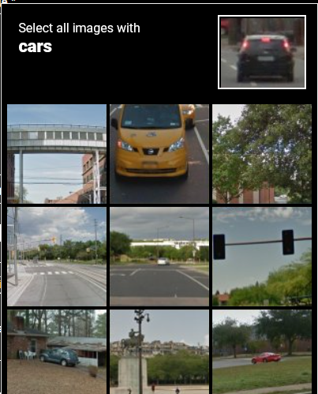
reCAPTCHA + AT = back to inaccessible CAPTCHA

Slide 16
Changes since July 2019 draft
reCAPTCHA now does a lot more identification about you as an individual to prepare for challenge
Updated guidance on how CAPTCHA now relies more on who you are specifically than knowing you are human

Slide 17
Next steps
Current draft (6 July 2018): https://www.w3.org/TR/turingtest/
Second draft approved internally, will turn up online any day now at same URL so watch www.w3.org/WAI for announcement
Call for feedback will be part of announcement

Slide 18
Further information
E-mail: scott@hollier.info
Website: hollier.info
Mobile: +61(0)430 351 909
Twitter: @scotthollier
Newsletter: newsletter@hollier.info
Book: outrunningthenight.com

