Slide 1
What’s next in WCAG
An update on version 2.2
Notes:
Thank you so much for having me.
I’m really excited to share with you a sneak peak into WCAG version 2.2
In fact if some of what I’m saying sounds familiar…that because it is. I spoke at PWAC 2021 about the soon to be released WCAG 2.2
Well 2 years on and it really is ‘soon to be released' this time…I hope…no seriously it is!

Slide 2
Overview
WCAG 2.2 is currently a candidate for recommendation…again
9 additional success criteria expected
One current success criteria removed
One current criteria to move from a Level AA issue to a Level A issue.
Expected to be a W3C recommendation April 2023
Changes can still happen

Slide 3
WCAG versions
WCAG 1.0
WCAG 2.0
WCAG 2.1
WCAG 2.2
WCAG 2.x?

Slide 4
New Success Criteria
Guideline 2.4 Navigable
2.4.11 Focus Appearance (AA)
2.4.12 Focus Not Obscured (Minimum) (AA)
2.4.13 Focus Not Obscured (Enhanced) (AAA)
Guideline 2.5 Input Modalities
2.5.7 Dragging Movements (AA)
2.5.8 Target Size (Minimum) (AA)
Guideline 3.2 Predictable
3.2.6 Consistent Help (A)
Guideline 3.3 Input Assistance
3.3.7 Accessible Authentication (AA)
3.3.8 Accessible Authentication (No Exception) (AAA)
3.3.9 Redundant Entry (A)

Slide 5
2.4.11 Focus Appearance (AA)

Slide 6
2.4.7 Visible Focus

Slide 7
2.4.12 Focus Not Obscured (Minimum) (AA)
When a user interface component receives keyboard focus, the component is not entirely hidden due to author-created content.

Slide 8
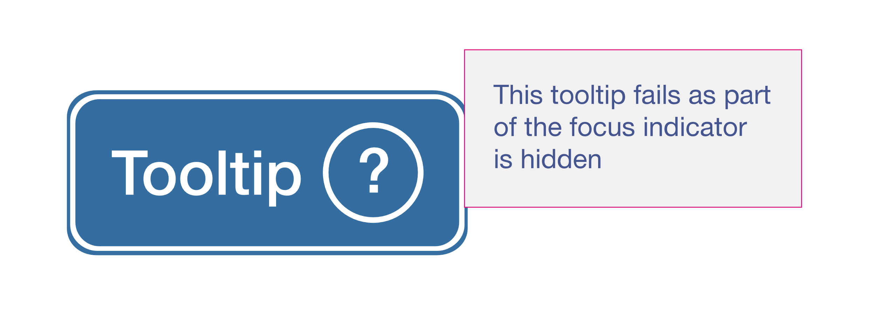
2.4.13 Focus Not Obscured (Enhanced) (AAA)
When a user interface component receives keyboard focus, no part of the focus indicator is hidden by author-created content.

Slide 9
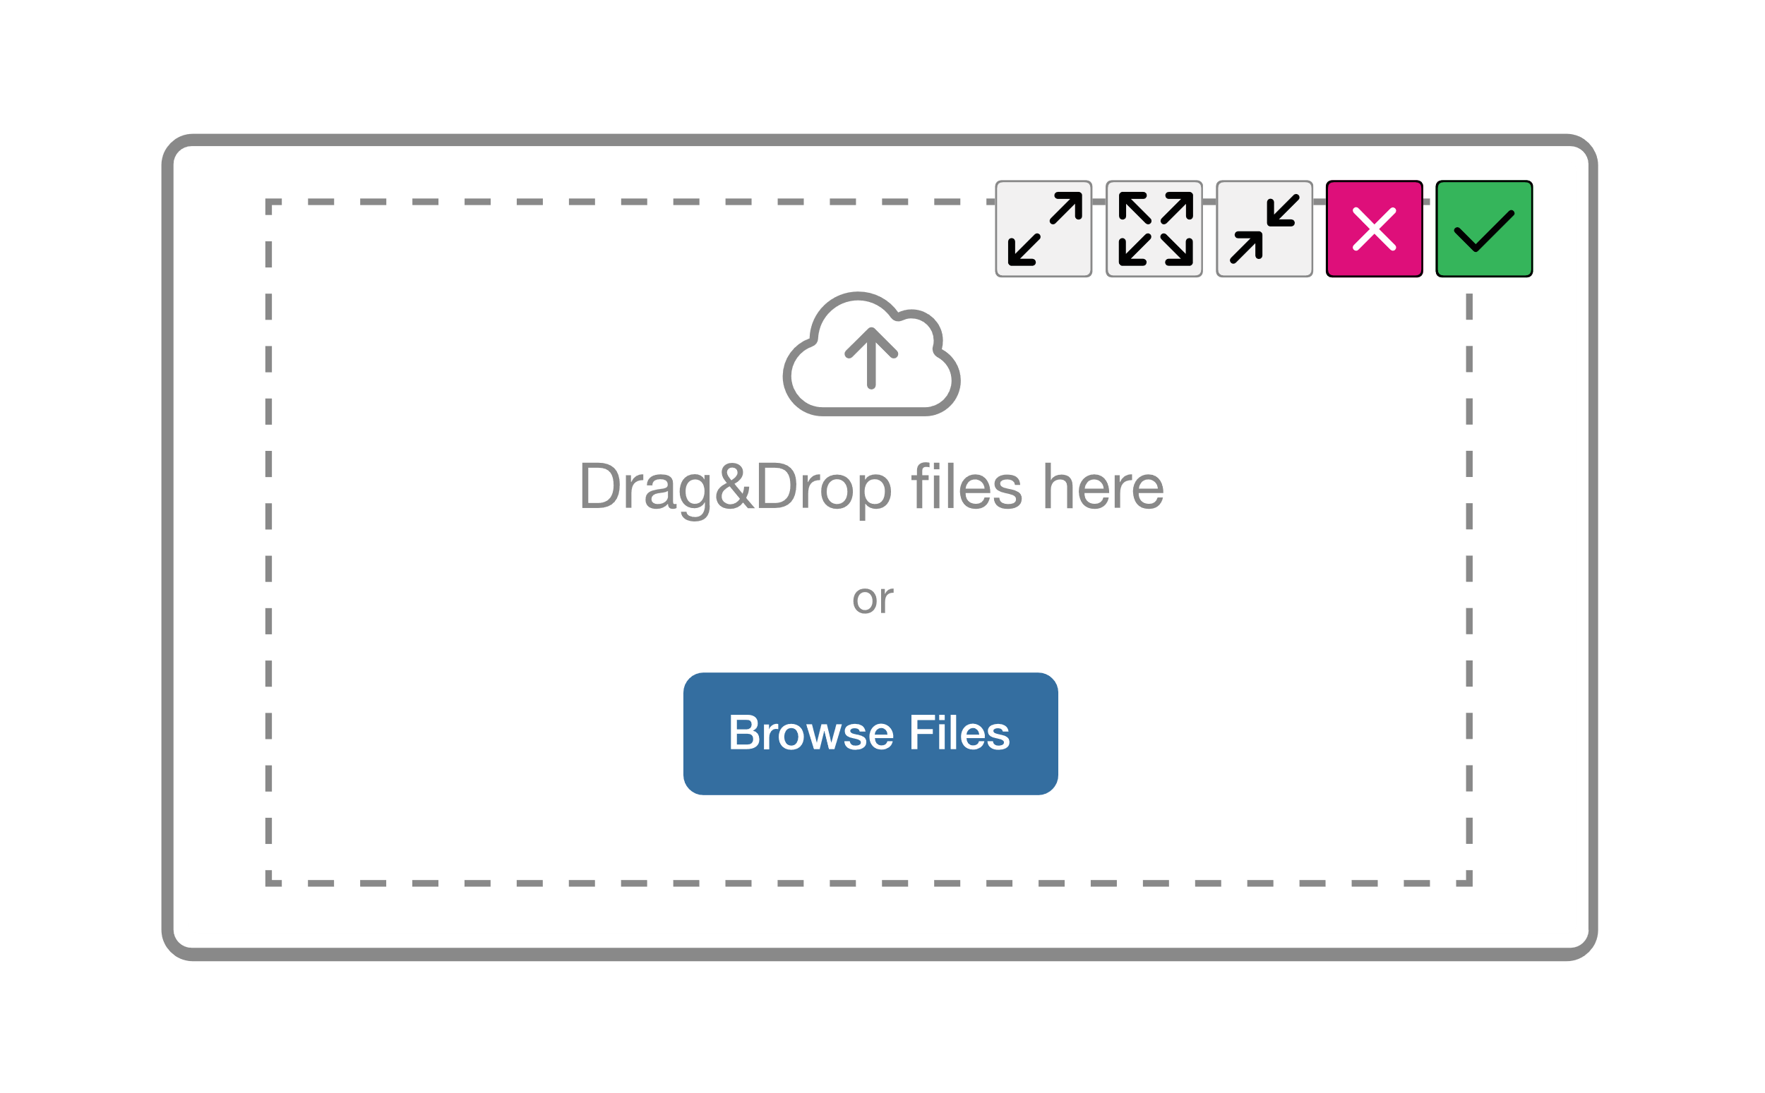
2.5.7 Dragging (AA)
All functionality that uses a dragging movement for operation can be achieved by a single pointer without dragging, unless dragging is essential or the functionality is determined by the user agent and not modified by the author.

Slide 10
2.5.8 Target Size (Minimum) (AA)
The size of the target for pointer inputs is at least 24 by 24 CSS pixels, except where:
Spacing: The target offset is at least 24 CSS pixels to every adjacent target;
Equivalent: The function can be achieved through a different control on the same page that has an area of at least 24 by 24 CSS pixels;
Inline: The target is in a sentence or block of text;
User agent control: The size of the target is determined by the user agent and is not modified by the author;
Essential: A particular presentation of the target is essential or is legally required for the information being conveyed.

Slide 11
3.2.6 Consistent Help (A)

Slide 12
3.3.7 Accessible Authentication (Level AA)
A cognitive function test (such as remembering a password or solving a puzzle) is not required for any step in an authentication process unless that step provides at least one of the following:
Alternative: Another authentication method that does not rely on a cognitive function test.
Mechanism: A mechanism is available to assist the user in completing the cognitive function test.
Object Recognition: The cognitive function test is to recognize objects.
Personal Content: The cognitive function test is to identify non-text content the user provided to the website.

Slide 13
3.3.8 Accessible Authentication (No Exception) (AAA)
A cognitive function test (such as remembering a password or solving a puzzle) is not required for any step in an authentication process unless that step provides at least one of the following:
Alternative: Another authentication method that does not rely on a cognitive function test.
Mechanism: A mechanism is available to assist the user in completing the cognitive function test.

Slide 14
3.3.9 Redundant Entry (A)

Slide 15
Obsolete – 4.1.1 Parsing

Slide 16
Supporting Docs

Slide 17
Implementation in Australia
Notes:
.

Slide 18
Thank you
Email
amace@abledocs.com
LinkedIn ​
https://www.linkedin.com/in/amanda-mace-85171b77/ ​

