Slide 1
Supporting High Contrast
Julie Grundy
Senior Digital Accessibility Consultant

Slide 2
High contrast themes
Notes:
HC themes are an assistive technology which is often used by people with low vision. But there's not a lot of support information about them out there, so today I want to fill in some detail for you.

Slide 3
Contrast themes
In all operating systems
Windows has best user control

Slide 4
Finding high contrast mode
Notes:
You can try this out in Windows by going to the Ease Of Access area, and choosing High Contrast from the Vision options. After you turn it on using the toggle, you can pick one of the preset themes.

Slide 5
The High Contrast setting page
Notes:
So this is that same settings page but now I've turned on the default High Contrast Black theme.

Slide 6
The customisation options
Notes:
All of those coloured blocks there tell you what colour your text, background and links will change to. Clicking them opens a colour picker which will let you choose literally any colour your monitor can do. The beauty of this is that everyone can choose exactly what works for them – not everyone with a vision impairment has the same needs. The problem is that everyone can choose exactly what works for them, and those of us making websites have exactly zero idea what colours they've picked out of the billion potential combinations.

Slide 7
Not always *high* contrast
Many people with low vision choose lower contrast combinations to suit their specific needs
Notes:
This includes low contrast combinations of colours as well. Some vision impairments mean that people are trying to avoid eye strain and glare, so they want to keep things softer rather than brighter.

Slide 8
Who uses them?
30% of people with low vision WebAim's 2018 survey
4% of Windows users Melanie Richards, MS Edge
Notes:
Who is using this powerful tool? Which includes our very own Dr Scott Hollier.

Slide 9
What does it do?
All colours are now under control of the user (Windows) or the operating system (everywhere else)
Images will stay but may be modified
Notes:
How does it work?

Slide 10
Supporting WHCM
Notes:
In practice I find that there are very few problems any more with images and text in high contrast, so we want to focus our efforts on the user interface when we're supporting this user group. I'm going to step you through a demo as I improve a basic page layout.

Slide 11
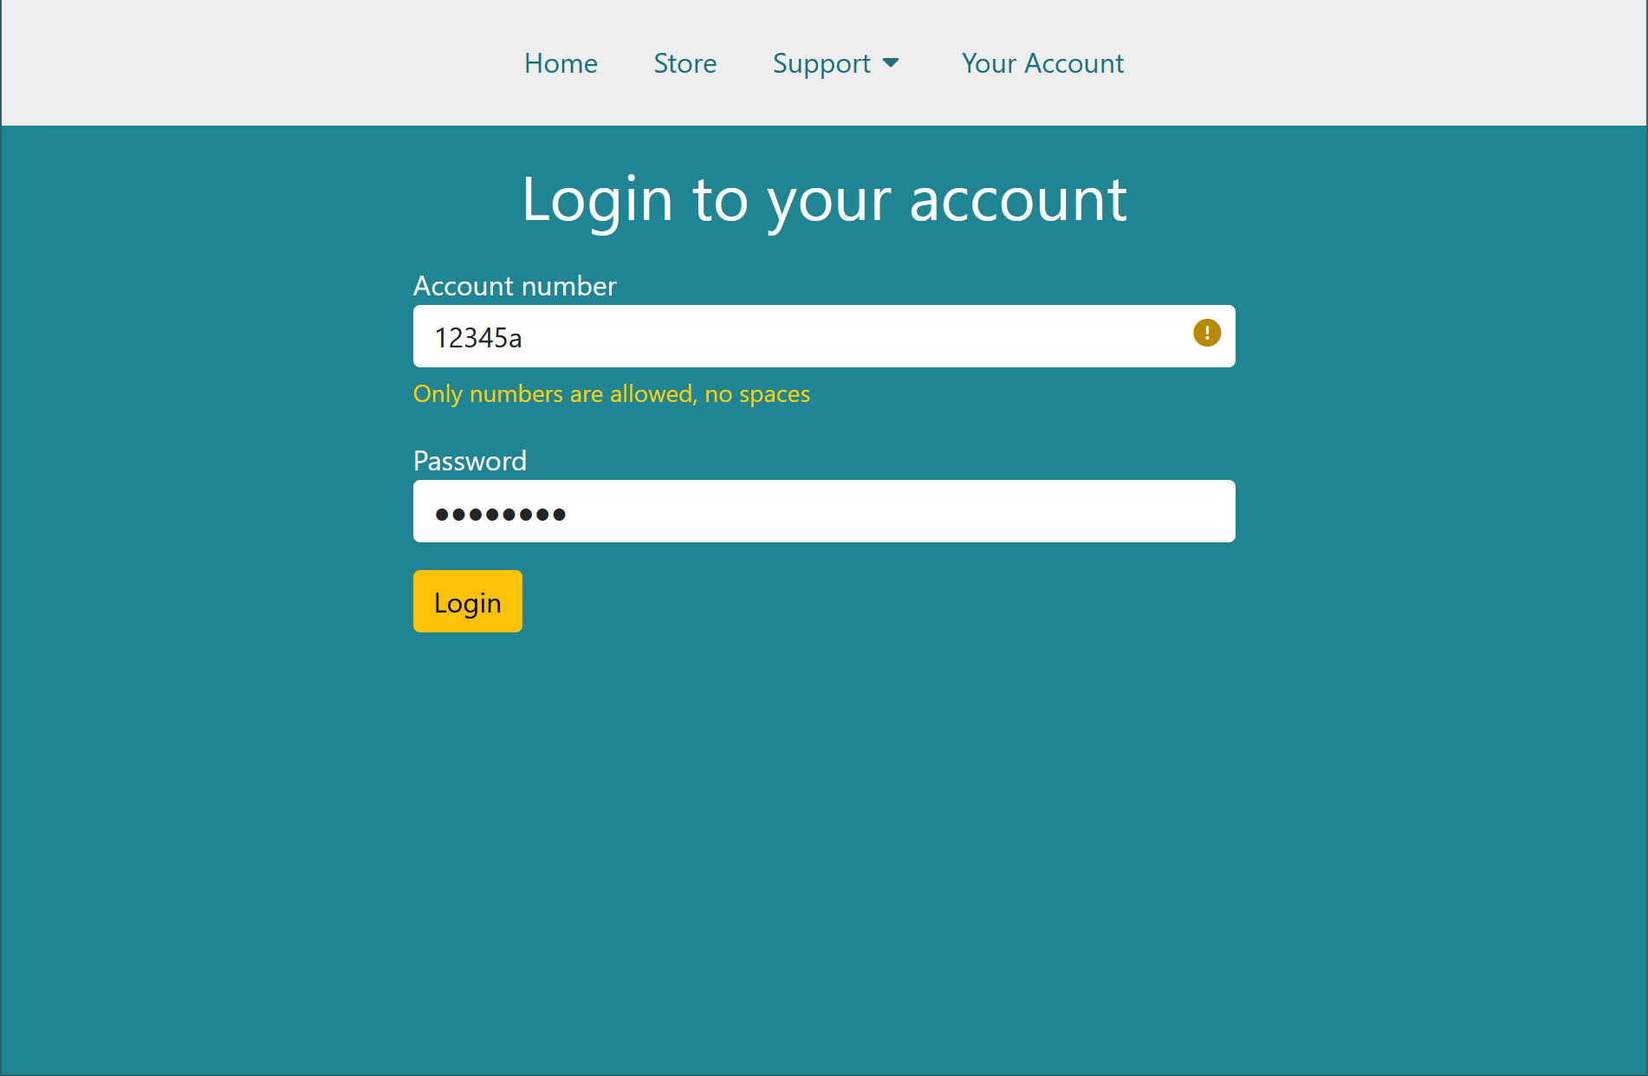
Demonstration
Notes:
Here's my little demonstration page. We've got a short menu, one of the menu items has a sub-menu. And there's a little form, with one of the fields in an error state.

Slide 12
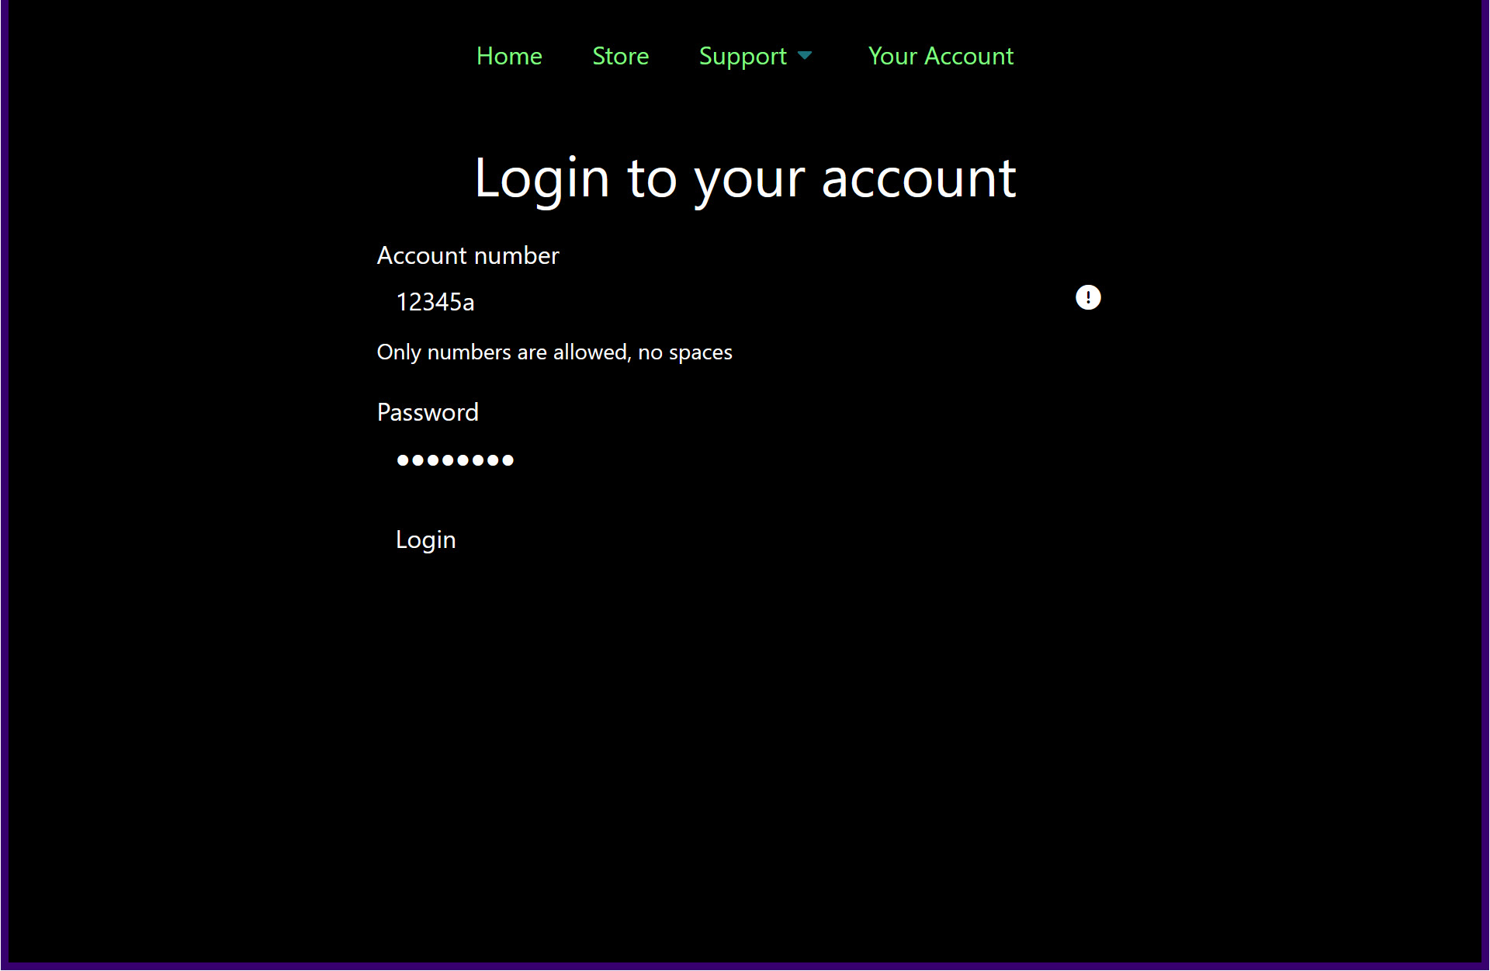
Same page, more contrast
Notes:
But if we look at it in high contrast mode, we see some problems here. I've just chosen one of the pre-set high contrast themes, I haven't changed the colours from the default settings at all.
No idea what size the form fields are…
It's good that the icon for the error state has showed up, but zoomed in users could easily miss the error state
So how can we start fixing this?

Slide 13
Your most important tool
.item { border-width: 1px; border-style: solid;
}
Notes:
Borders are always respected in high contrast mode. Their colour might change, but the shape stays the same. So let's add some borders to the inputs and button.

Slide 14
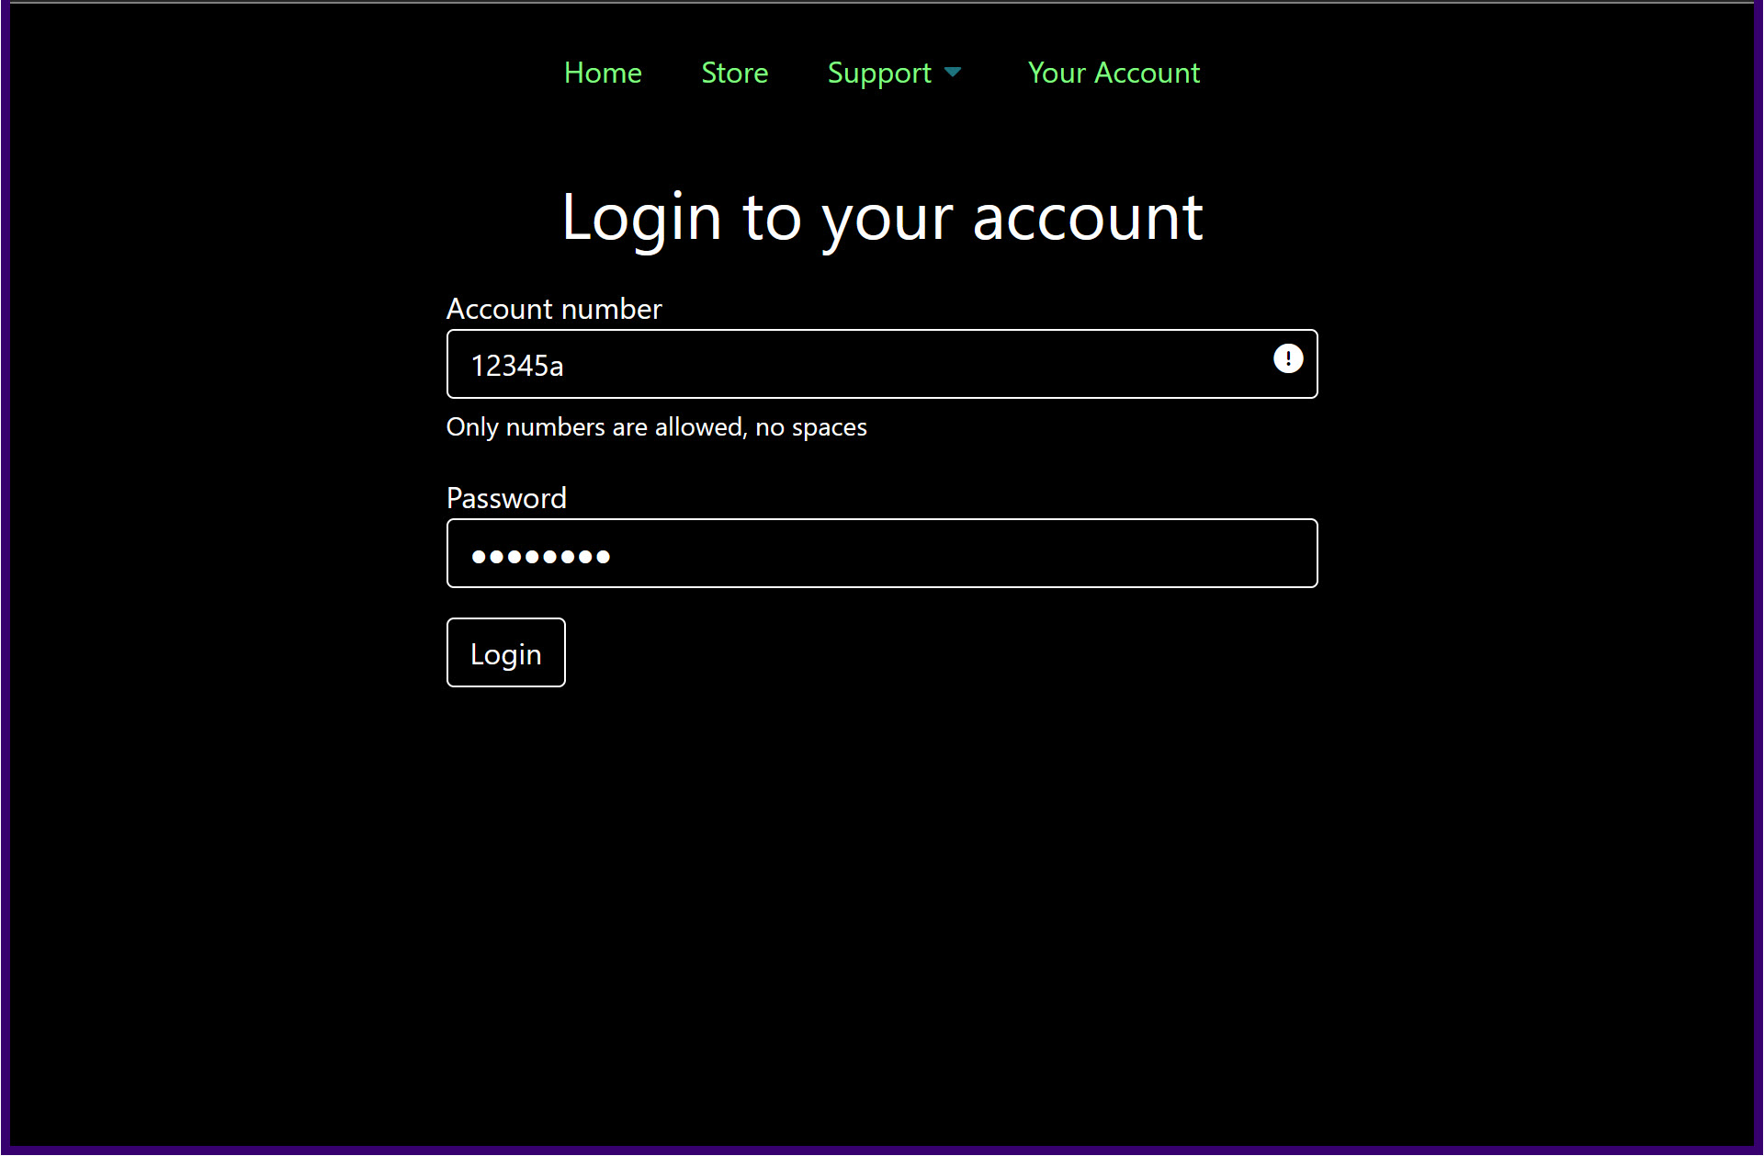
Demo with borders
Notes:
That's much better. If you only do one thing to support your high contrast users, I want it to be this.

Slide 15
Border choices
border: 1px solid #ced4da;
Notes:
Now sometimes the extra border looks a bit weird, or messes with your design. But we don't have to compromise!

Slide 16
Transparent is an option
border: 1px solid transparent;
Notes:
Because the colour doesn't matter, we can use the colour keyword 'transparent' if we like the visuals as they are.
Next, let's take a look at that sub-menu.

Slide 17
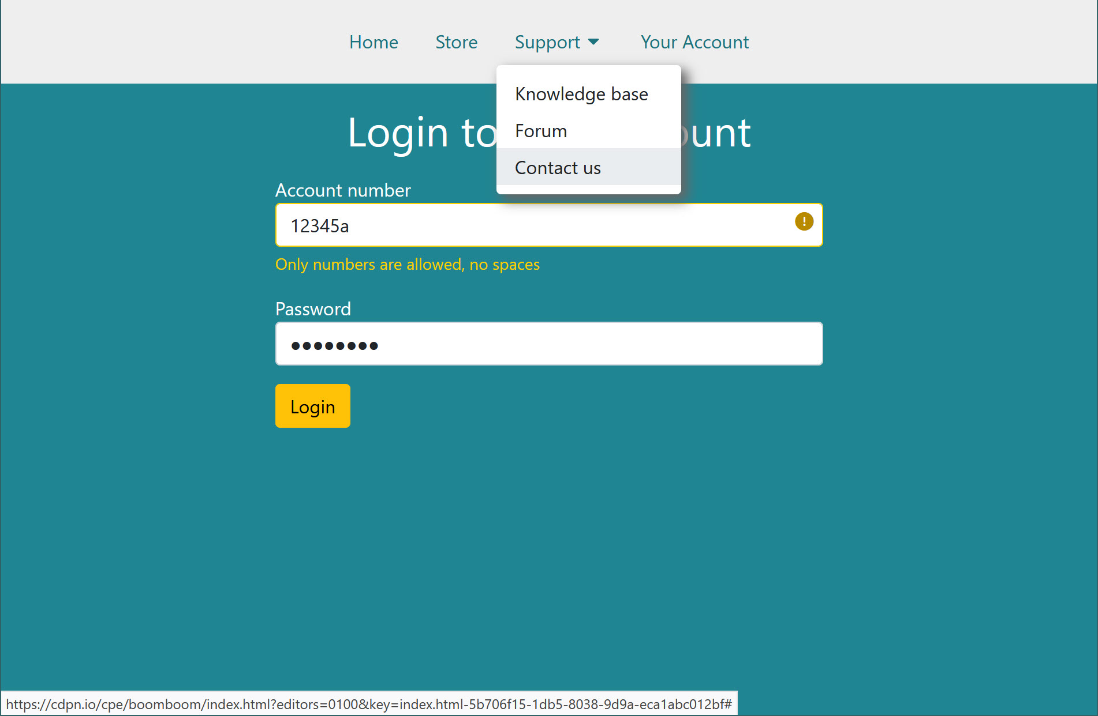
Focus and icons
Notes:
You can probably spot one problem here, which is that our focus style for the sub-menu item is just a background colour. Another problem is that the drop-shadow which defines the shape of the sub-menu isn't going to work in high contrast.

Slide 18
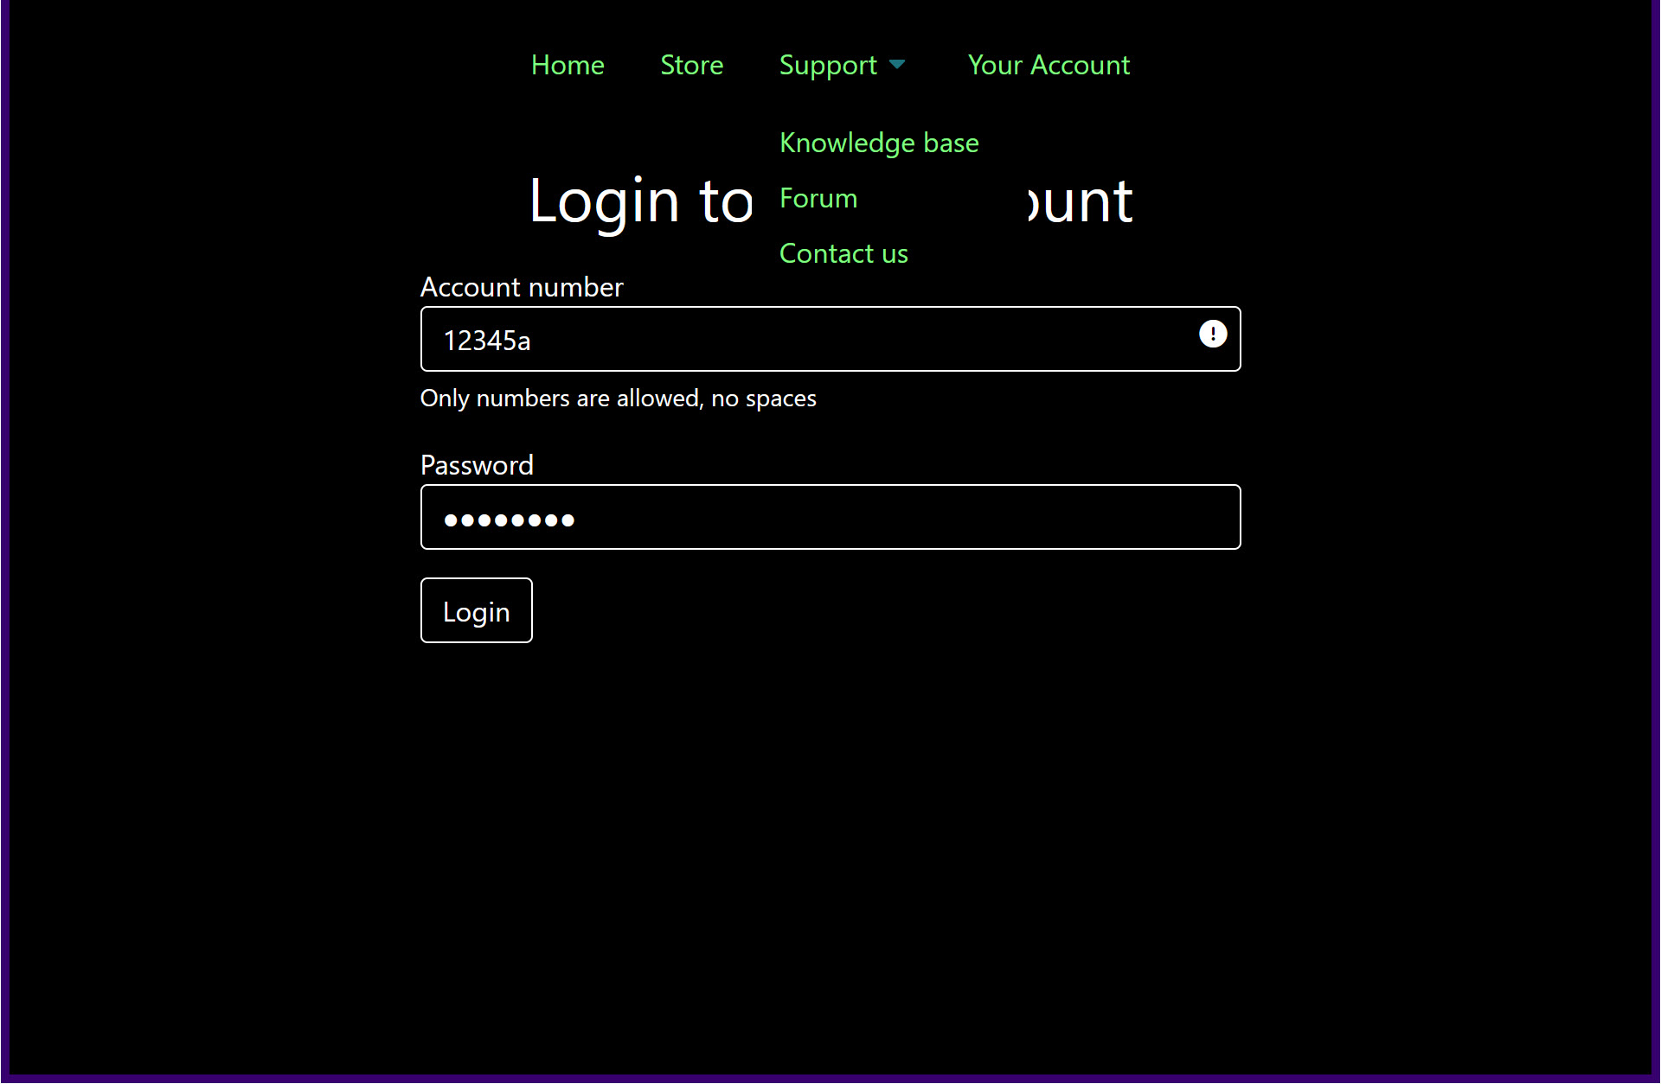
Focus and icons in high contrast
Notes:
And yeah, now that we're in high contrast, our menu text looks like it's bumping into our heading. We haven't got the visual signals to show that one is overlapping the other. This can be a real problem with modals too.

Slide 19
Overlapping content zoomed in
Notes:
The other problem is that a lot of people who use high contrast themes also need to zoom or magnify the screen, so we lose even more context for what's happening here because we can't see all of the text.

Slide 20
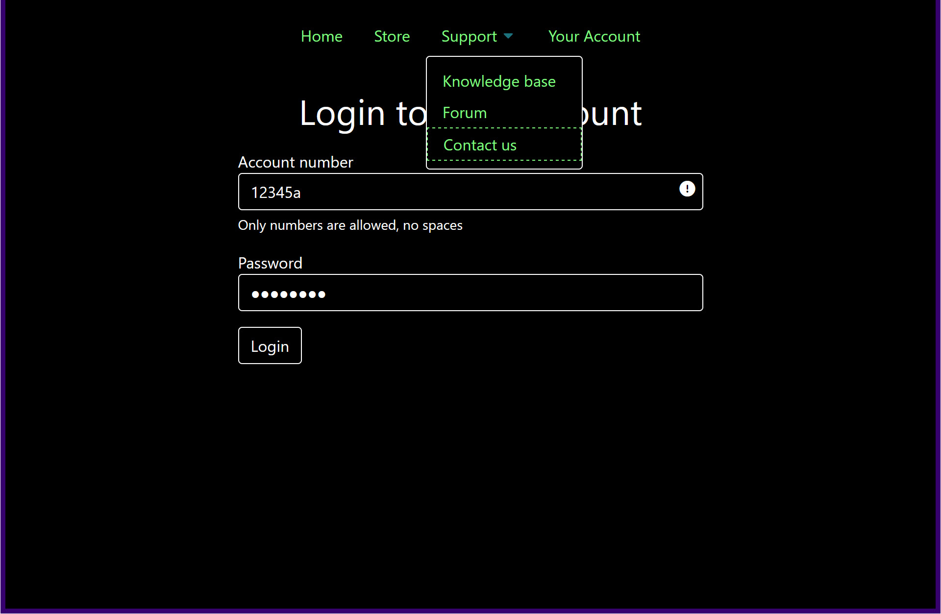
That's better
Notes:
So I've added a border around the sub-menu, and for the focusable item I've made it a bit fancy by making it dashed. There's no need for that, I just got bored of solid lines while I was making the demo.

Slide 21
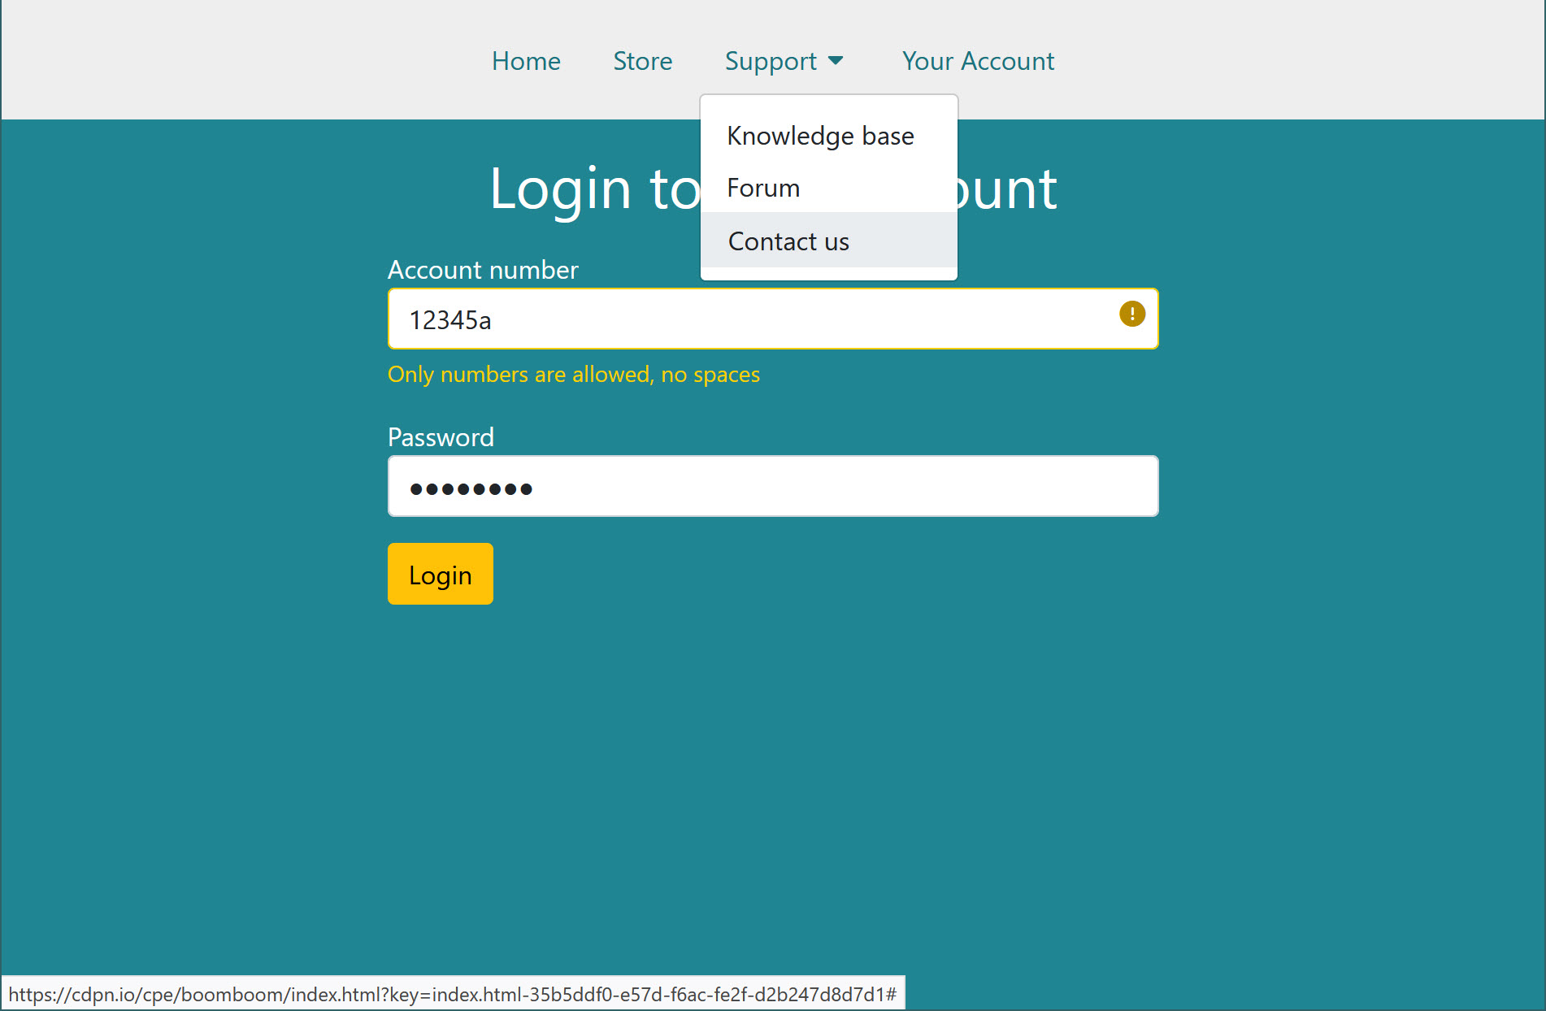
A slight difference back in standard mode
Notes:
Now that we look at it back in standard colours, you can see that I've removed the drop-shadow. You could keep it if you want, it's not hurting anything.

Slide 22
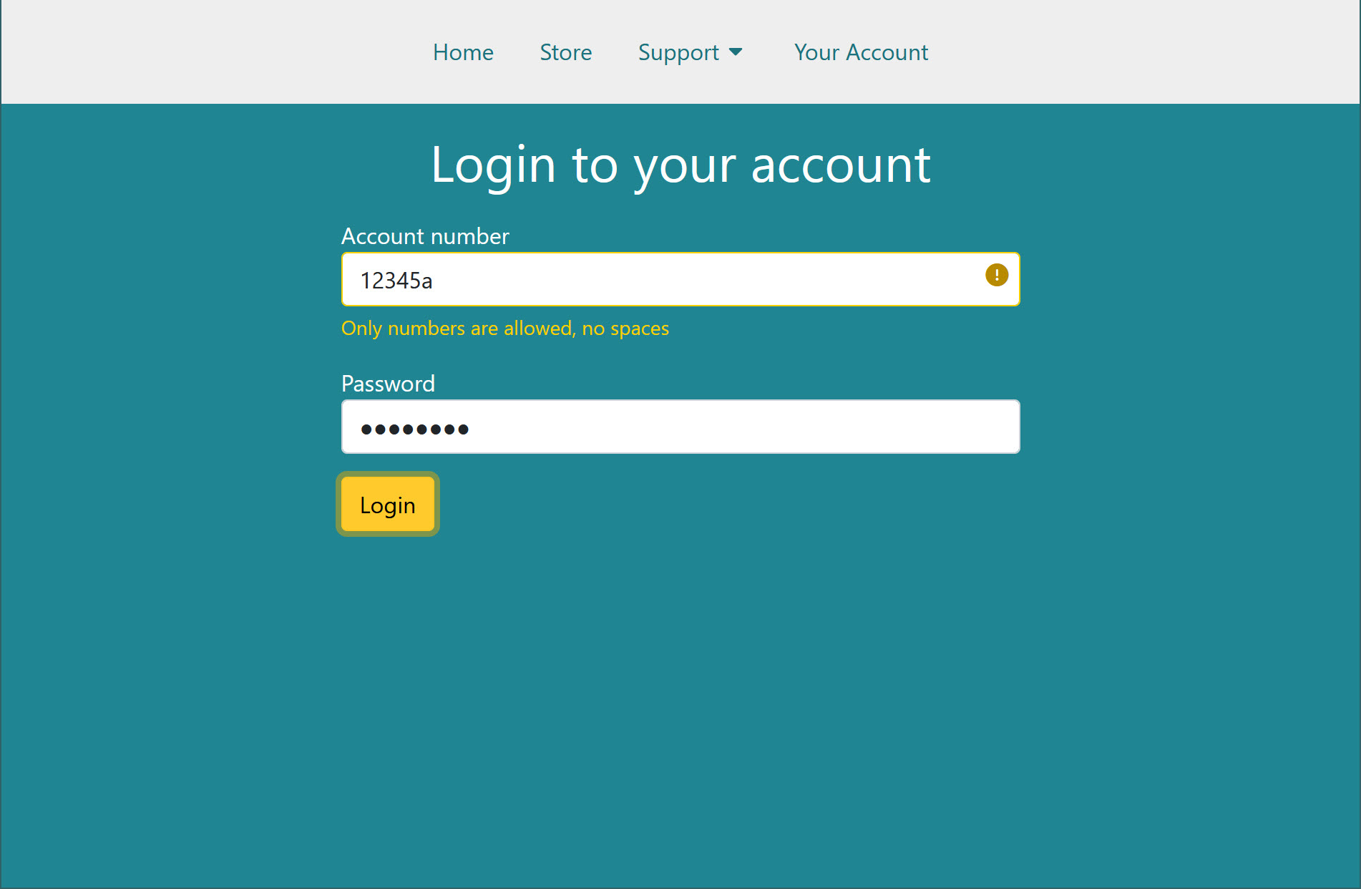
Focus with shadows
Notes:
Now let's check our focus styles. On this site, links in the menu get underlines on hover/focus, inputs get the cursor, but this focus style on the button here uses a kind of half-transparent box shadow. It's also ugly, but it does technically pass all of our WCAG criteria.

Slide 23
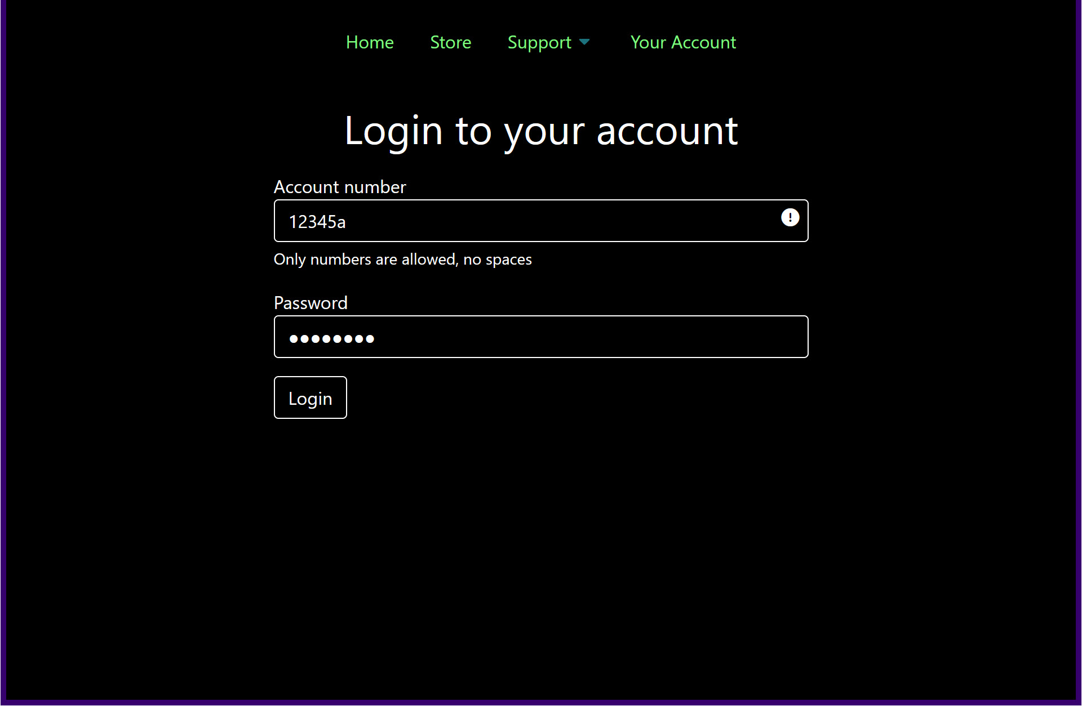
Shadows don't appear in high contrast
Notes:
You guessed it - when we look at it in high contrast mode, the focus style has been stripped out and we've got no way of knowing if it has focus or not. Now, we can't use border styles here because it already has a border. What we're going to do instead is use the outline property.

Slide 24
Outline for focus styles
.btn:focus { outline: 1px solid #005A66; outline-offset: 1px; }
Notes:
This is why I always use the outline property as part of my focus styles, because it doesn't clash with the border styles of anything else. You can use the transparent keyword here as well.

Slide 25
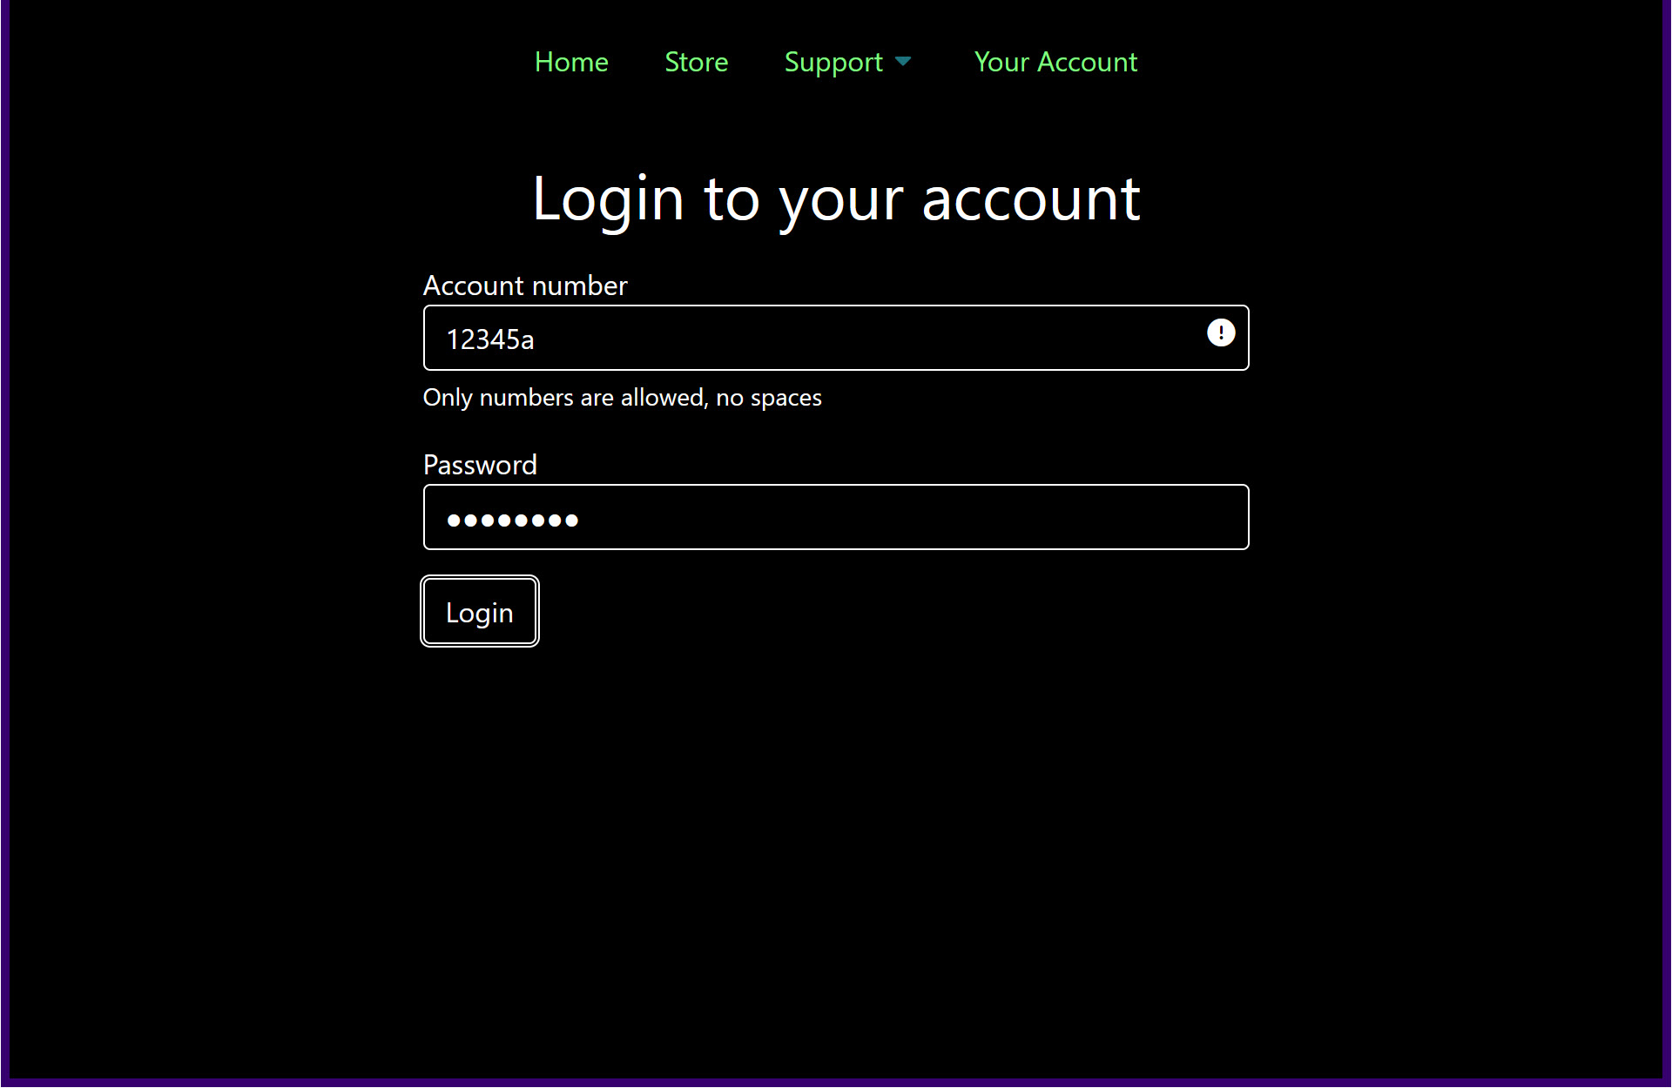
Focus with outline
Notes:
So let's check back in high contrast. There's our button with that outline style applied…

Slide 26
The difference in standard mode
Notes:
And here's the change back in standard mode. The limitation of outline is that you can't use it at the same time as box-shadow, the box-shadow always overrides it. So that's another reason I'm not keen on box-shadow for focus styles, it cramps my outline styles.
So what's left to do?

Slide 27
One last thing
Notes:
If we pop back into high contrast mode to check everything, we can still see a small problem. The little arrow marker which shows the Support menu has a sub-menu hasn't changed colour. Why is that? Our alert icon for the invalid field changed, but that's because it's an icon font. So Windows treats it just like text. But the sub-menu icon is an SVG embedded in the page. It was styled using CSS, but SVG support is still a bit patchy at the edges. So Windows hasn't changed it. The original colour is low contrast against the black background in this example, but remember that people can choose any colours they like. All of those 30% of people with low vision will have chosen different colours – we can't predict what the contrast might be, or whether they need high or low contrast. So!

Slide 28
Next important tool
System colour keywords
https://drafts.csswg.org/css-color/#css-system-colors
e.g. LinkText, ButtonText, ButtonBorder
Notes:
What we're going to do is use our next most important tool for high contrast support, which is the System Color keywords. These are mostly standardised colour keywords you can use, and they tie in to the Windows High Contrast settings. Remember when I showed you that people could choose the colour of their text, their links, and so on? Those become the system colour for that high contrast theme. There aren't a lot of these, but they cover the really useful stuff for user interfaces – text colour, background colour, link colour and button styles.

Slide 29
Use System Color for SVGs
Lets them adapt to the chosen colours
.dropdown-toggle svg {
fill: LinkText;
}
Notes:
What I'm going to do here is change the fill in the SVG from the hex colour value of the menu links, to the System Colour called LinkText. The SVG is part of a menu link, so I want it to look like whatever colour that ends up as.

Slide 30
The improved icon in high contrast
Notes:
And here we are back in high contrast, with a little sub-menu marker set to the System Colour for links that the high contrast user chose. What's even better…

Slide 31
Our final result in standard mode
Notes:
Is that it also picks up the link colour in standard mode as well. Because the System Color for link text is usually set by CSS, until a high contrast theme is turned on. No compromises, we can give everyone the colour that works best for their setup.

Slide 32
Your final tool
When borders, outlines and System Color keywords aren't enough, you have one more option

Slide 33
Media query forced-colors
.@media (forced-colors: active) {
.button SVG {fill: ButtonText;}
.menu SVG {fill: LinkText;}
}
MDN forced-colors
Notes:
Which is using the media-query for forced-colors mode. This is just like your media query for the size of the viewport, or if the user prefers light or dark mode, but it's specifically for when users have chosen to force the colours of everything on their device.

Slide 34
forced-colors gives control
Most useful for complex SVG usage when re-using icons in different places
Notes:
Or if you really need to keep those box shadows on your focus styles, you can change them to outlines in forced-colors queries.

Slide 35
Need more info?
A Guide To Windows High Contrast Mode
by Cristian Diaz
at Smashing Magazine
Notes:
I could go on about Windows High Contrast Mode for hours, but if you need more info you should check out the [title] by [name] at Smashing Magazine.

Slide 36
Thankyou!
Training discount: PWAC-rules-23
Come talk to me, I love this stuff
Julie Grundy Senior Digital Accessibility Consultant
@Intopia
www.intopia.digital
hello@intopia.digital
Notes:
Thankyou so much for your time – I'll just quickly mention that Intopia has offered a training discount for all the lovely people attending PWAC today, online and in-person, but not for anyone watching this later on YouTube. The discount code is PWAC-rules-23, just email hello@intopia.digital and mention it while asking about our training.

