Slide 1
Higher Education For All
Dr Scott Hollier
PWAC 2023
1

Slide 2
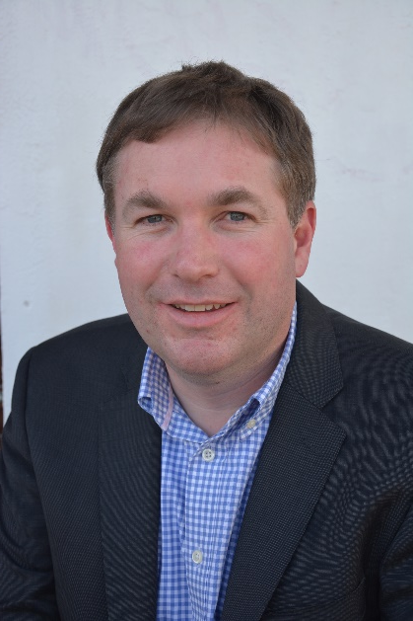
Who am I?
Professional:
Chief Executive Officer, CFA Australia
Co-convenor, W3C WAI Research Questions Task Force
Academic:
Senior Lecturer, Professional Certificate in Web Accessibility, University of South Australia
Adjunct Senior Lecturer, Edith Cowan University
Personal:
Author of book ‘Outrunning the Night’
Legally blind, first-hand knowledge of access issues

Slide 3
Acknowledgement
This project and its outputs have been funded by the Western Australian government, Department of Communities. Our thanks and appreciation to the department and the Hon. Don Punch, Minister for Disability Services, in the support of the project.

Slide 4
Higher Education for all project
Aim:
To support current and prospective students with disability by addressing the accessibility issues faced in university websites.
4

Slide 5
Testing process
Public facing critical information and content tested on UWA, Curtin, ECU, Notre Dame and Murdoch websites
Current student focus group
Other feedback from prospective and current students
Websites audited based on WCAG-EM 1.0 processes and WCAG 2.1 Level AA standard
Audit results provided to respective universities
Sector report created

Slide 6
Initial challenges – getting in touch
Notre Dame supportive of project from start and helped support grant application
Others initially reluctant about how report would be framed but very supportive as project progressed

Slide 7
Findings – current students
Difficult for prospective students to contact disability support
Online learning support better than face-to-face
Captions on videos helpful
Lecturers didn’t always use microphones so content missing from video
LMS navigation structure changing in each unit
Campus disability maps terrible
Colour contrast
Non-descriptive links e.g. ‘Click here’
LMS not being used correctly, e.g. all content in inaccessible PDF
Lack of accessible campus map
Lack of digital classroom information about which rooms are wheelchair accessible

Slide 8
Key issues
Alternative text
Colour contrast
Navigation
Link purpose
PDF documents
Code validation

Slide 9
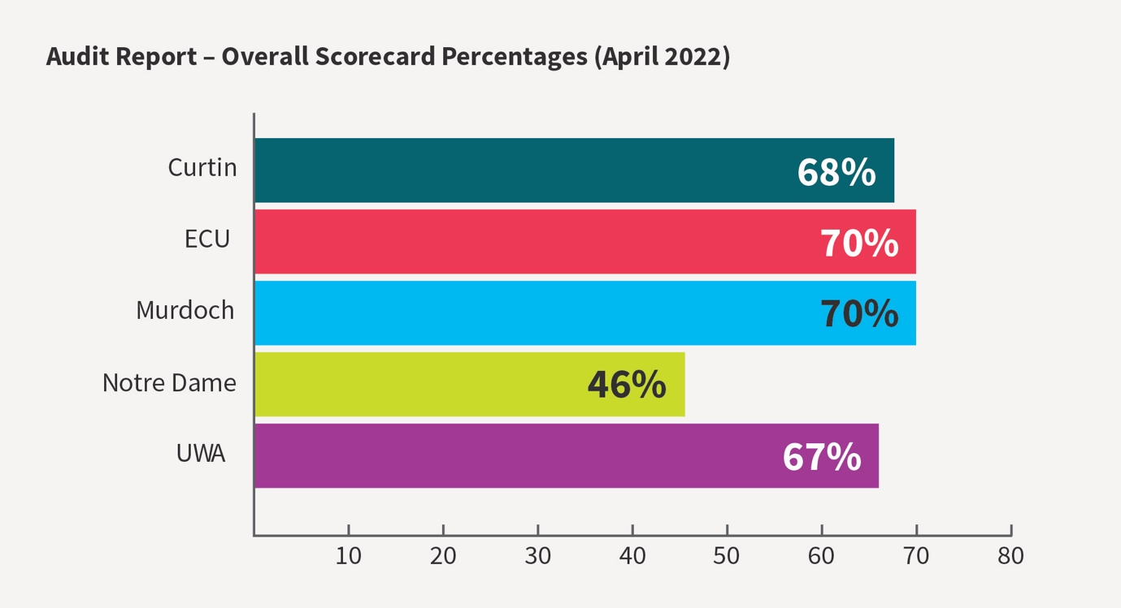
Scorecard

Slide 10
Student response
Students acknowledge that some of their concerns are being addressed
More work needs to be done, especially in terms of LMS consistency and equal footing between online and in-class students.
Campus maps remain a concern.

Slide 11
Industry response
Most universities have indicated that they have taken the audit findings on board
Anecdotal evidence suggests improvements have been made across all universities involved in the project
This training will help address some questions raised about how to address specific issues.

Slide 12
Training identified
Most university staff outside of specific disability support staff do not have direct user experience in how people with disability use assistive technologies.
All universities have some knowledge of digital access issues, but processes allow issues to fall through the cracks.
Other digital access issues are largely unknown.
Workshops provided to marketing/comms and ICT staff.

Slide 13
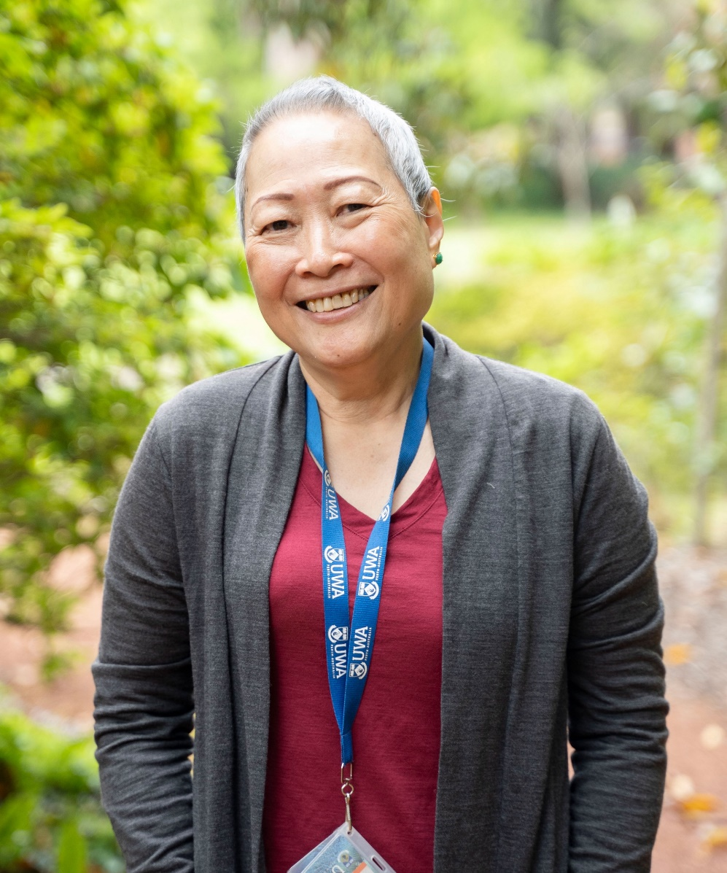
“Digital accessibility is important. It's not just materials, it’s also the experience itself. It's a holistic experience of being in a place supported by digital tools.” - Irene

Slide 14
Report and feedback
The report is available now from the Policy and Research - Centre For Accessibility Australia website.

Slide 15
Further information
E-mail: scott.hollier@accessibility.org.au
Website: accessibility.org.au
Mobile: 0430 351 909
Twitter: @scotthollier
Membership: accessibility.org.au/membership
Book: outrunningthenight.com

