Slide 1
Accessibility Acceptance Criteria (AAC)
Melanie O'Brien
Digital Accessibility Manager

Slide 2
Contents
Background & context
List of 10 AACs
How we implement them

Slide 3
Why we created the AACs

Slide 4
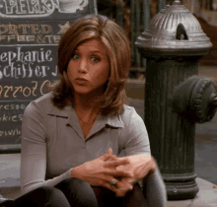
A11y requirements are hard to understand

Slide 5
What are Accessibility Acceptance Criteria (AAC)

Slide 6
What are the AACs
A set of 10 accessibility criteria included in user stories to improve accessibility compliance & usability.
Define the A11y boundaries of a user story
Confirm when a story is closed
Define testable conditions for A11y
What they're not
WCAG success criteria
Accessibility requirements

Slide 7
Accessibility Acceptance Criteria
Write A11y ACs for the Agile team (BA, developer and tester).
Explain to the team why they are needed for a person with a disability and people with accessibility needs.

Slide 8
Guardrails

Slide 9
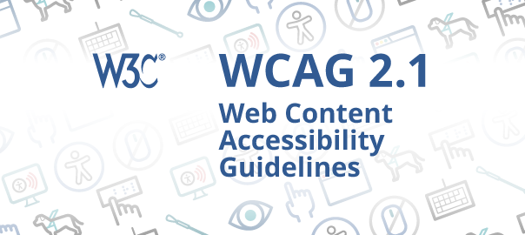
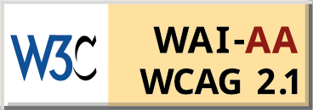
Key WCAG, A & AA
success criteria distilled into
10 A11y ACs

Slide 10
A11y Acceptance Criteria List

Slide 11
Accessibility Acceptance Criteria
Keyboard Accessibility
Content on hover
Page title
Visible focus
Semantic markup used appropriately
Form control labelling and inline errors
Screen reader
Zoom & resize
Alt text
Orientation & reflow

Slide 12
AACs - Deep Dive

Slide 13
AAC #1 keyboard accessibility.
“Given I’m a keyboard user
when I encounter interactive content I can control it solely from the keyboard.”
Maps directly to success criteria 2.1.1 keyboard and 2.1.2 keyboard trap.

Slide 14
AAC #5 Semantic mark up used appropriately
“Given I navigate with assistive technology when I encounter content which looks different then I can perceive this difference. E.g. heading structure, ordered and unordered lists.”
Maps to WCAG SC 1.3.1 Info & relationships

Slide 15
AAC #7 Screen reader
“Given I use a screen reader when a visual change occurs on the page then I can understand the change audibly. E.g. search results displaying while searching, errors displaying after activating submit button.”
Maps directly to success criterion 4.1.2 Name, role, value.

Slide 16
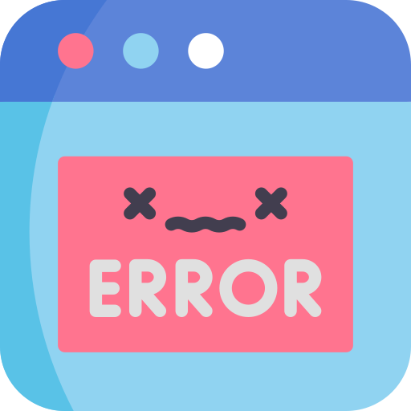
AAC #6 Form control labelling and inline errors
“Given I use a screen reader when I focus on form controls then I can understand what type of data is required.”
Maps to WCAG SC 1.3.1 Info & relationships, 3.3.1 Error identification and 4.2.1 Name, role, value.

Slide 17
User story example

Slide 18
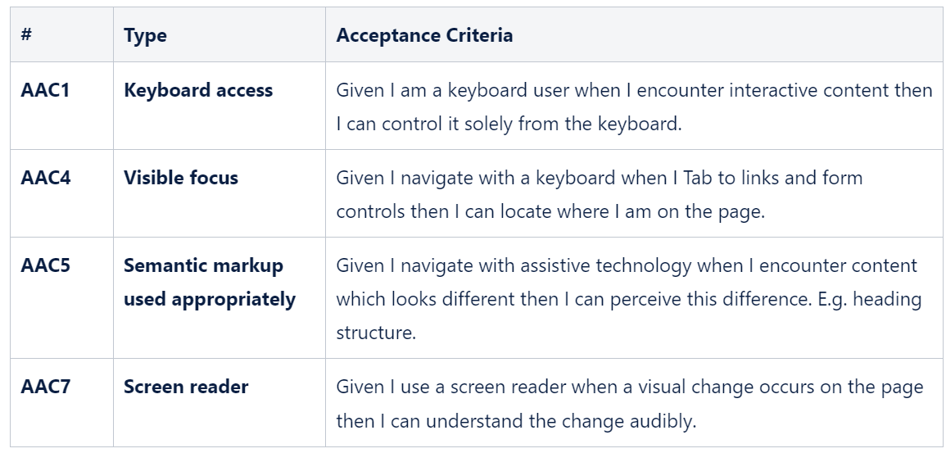
Applying AAC's to a user story
User story

Slide 19
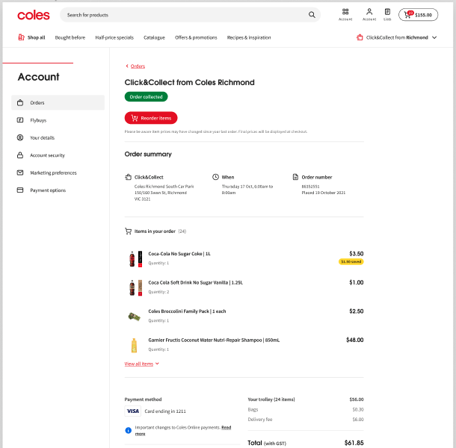
New functionality to add AAC's to
New functionality

Slide 20
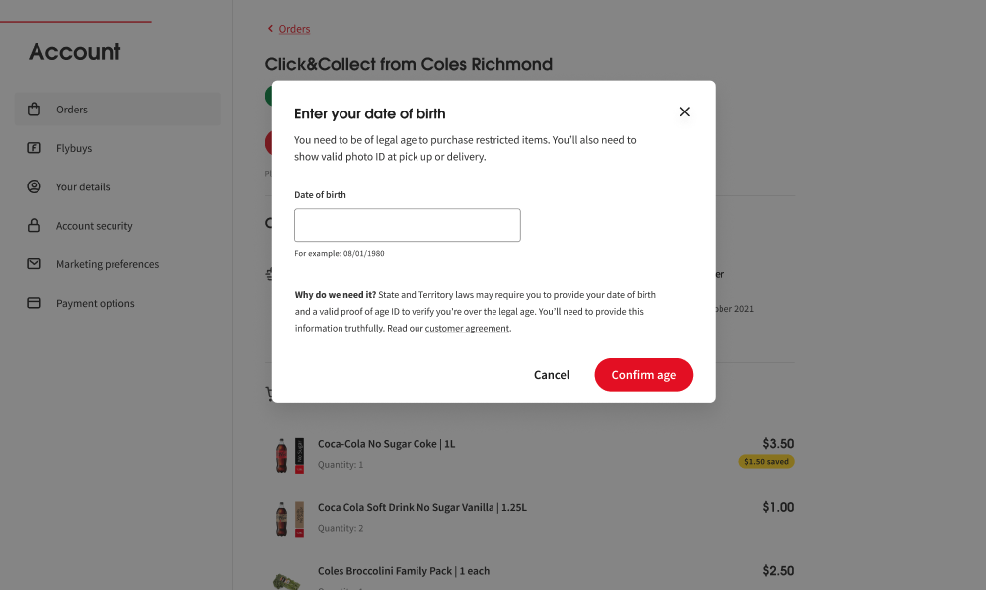
AAC's applied to the screens
AAC4
AAC1
AAC5
AAC2
AAC7
AAC4
AAC5
AAC4

Slide 21
Who uses the AACs in product delivery agile squads

Slide 22
Who uses the AAC
Accessibility Analysts: to communicate key A11y info to the squad about the component.​
BAs: to flesh out the user stories to incorporate A11y at the requirement phase in the delivery cycle. ​
Developers: as a guidepost and instructions about how to build accessible products. ​
Testers: to refer to when performing QA testing.​

Slide 23
Support

Slide 24
Supporting resources
A11y SME support
Companion doc
Training
Provide guidance from A11y analyst
Companion document; testing with the AACs ("How to guide")
Teach the Agile teams about the AACs and how to use them.

Slide 25
Summary

Slide 26
Summary
​
The AACs are a collection of 10 Acceptance Criteria specifically for accessibility to make it easier for A11y to be included early on.
They can be incorporated into user stories to improve usability and compliance to WCAG 2.1 A & AA. ​
They define the boundaries of a user story, confirm when a story is working as intended and define testable conditions for A11y.

Slide 27
Thank you

